Slide 1

22AIE201 – FUNDAMENTALS OF AI
INTELLIGENT TRAFFIC SIGNAL CONTROLLER
GROUP -11
TEAM MEMBERS:
HEMANTH S N -CB.SC.U4AIE24321
JASWANTH SARAVANAN -CB.SC.U4AIE24324
MAHAKISORE M -CB.SC.U4AIE24333
YASHWANTH B -CB.SC.U4AIE24360

Slide 2
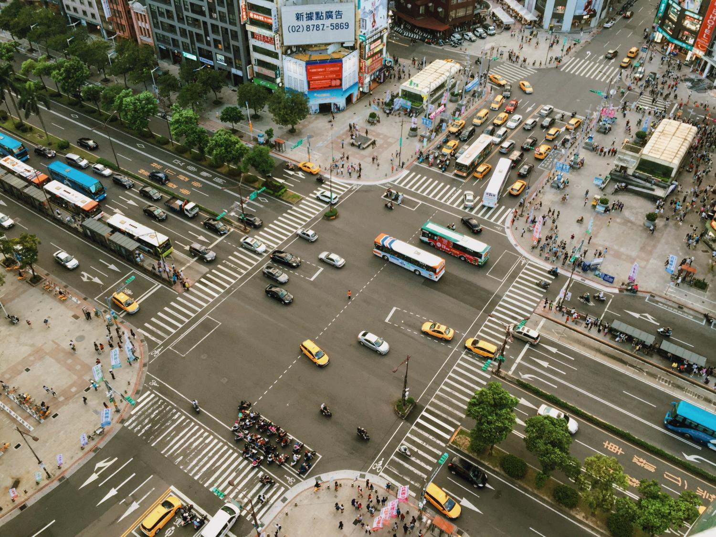
Problem Statement
Traffic congestion is a major urban problem, leading to delays and increased
emissions.
Traditional traffic lights operate on fixed timings, which are inefficient and cannot adapt to dynamic traffic fluctuations.
There is a critical need for adaptive traffic control systems that respond in real-time to current traffic conditions, optimizing flow and minimizing congestion.

Slide 3
Objectives
To design and implement a Q-learning-based traffic light controller capable of real-time adaptation.
To implement a heuristic model, specifically Longest Queue First (LQF), to serve as a comparative baseline.
To utilize SUMO (Simulation of Urban MObility) to create and simulate a realistic traffic environment.
To conduct a comprehensive performance comparison of the developed adaptive controllers against traditional fixed-time signal systems.

Slide 4
The Big Picture: What We Are Building
Intro: Imagine your traffic intersection is a video game.
The World:
The intersection, roads, and cars are the “world” of the game.
We build this world using SUMO.
The Brain:
The traffic light needs a “brain” to make smart decisions.
Instead of a fixed timer, this brain will look at the traffic and decide which way should get the green light.
We will build this brain using a Python script.
The Connection:
We need a way for the Python brain to talk to the SUMO world.
This connection is made possible by TraCI, like a radio that lets our script:
Get info from the simulation (“how many cars are waiting?”)
Send commands (“change the light to green!”)
We will build this in three parts:
Building the Simulation World (Using SUMO Files)
Creating the “Longest Queue First” Brain (Python Script)
Connecting the Brain to the World and Running the Project

Slide 5
Methodology (Planned)
Network Creation
Develop a detailed 4-way intersection in SUMO, including multiple lanes and proper signal configurations.
Route File Creation
Define realistic vehicle flow patterns with varying turn probabilities to
simulate dynamic traffic demands.
Heuristic Model Implementation
Program the Longest Queue First (LQF) algorithm to establish a robust baseline control strategy.
Evaluation
Quantitatively compare the performance metrics of the Q-learning agent and LQF heuristic against fixed-time signaling.
Training
Execute multiple simulation episodes to train the Q-learning agent, allowing it to converge on optimal policies.
Q-Learning Agent Design
Define appropriate states(queue lengths, phase), actions (signal changes),and reward functions (negative waiting time,delay) for optimal learning

Slide 6
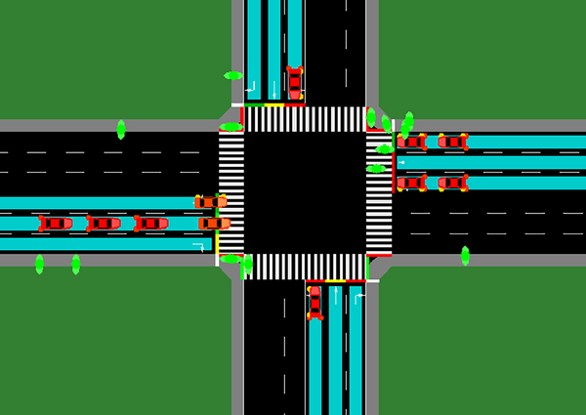
Heuristic Model – Longest Queue First (LQF)
Concept: Prioritizes the traffic approach with the highest number of waiting
vehicles by granting it a green light.
Steps: Continuously measures queue lengths for all approaches, identifies the longest queue, switches the traffic signal to green for that approach, and repeats the process after a predefined minimum green time.
Advantages: Simple to implement, requires no prior training, and offers quick
adaptability to sudden traffic changes.
Limitations: Can make myopic (short-sighted) decisions, may lead to starvation of less congested approaches, and can cause frequent signal switching which may increase overall delay in some scenarios.
Role in Project: Serves as a vital practical baseline for evaluating the superior performance of the Q-learning approach under various traffic conditions.

Slide 7
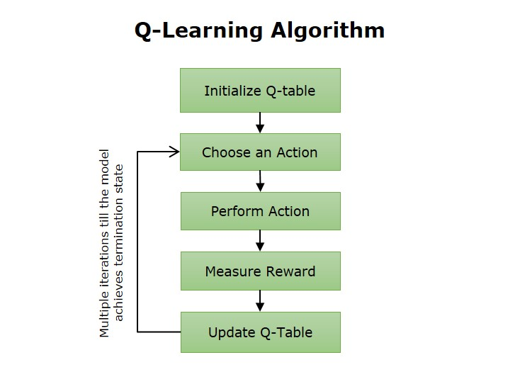
Q-Learning Approach
Definition:
Q-learning is a reinforcement learning algorithm used to train agents to make decisions through trial and error.
Goal:
Learn the best action to take in each situation to maximize rewards over time.
Key Idea:
The agent updates a Q-table that stores values for each state-action pair.

Slide 8
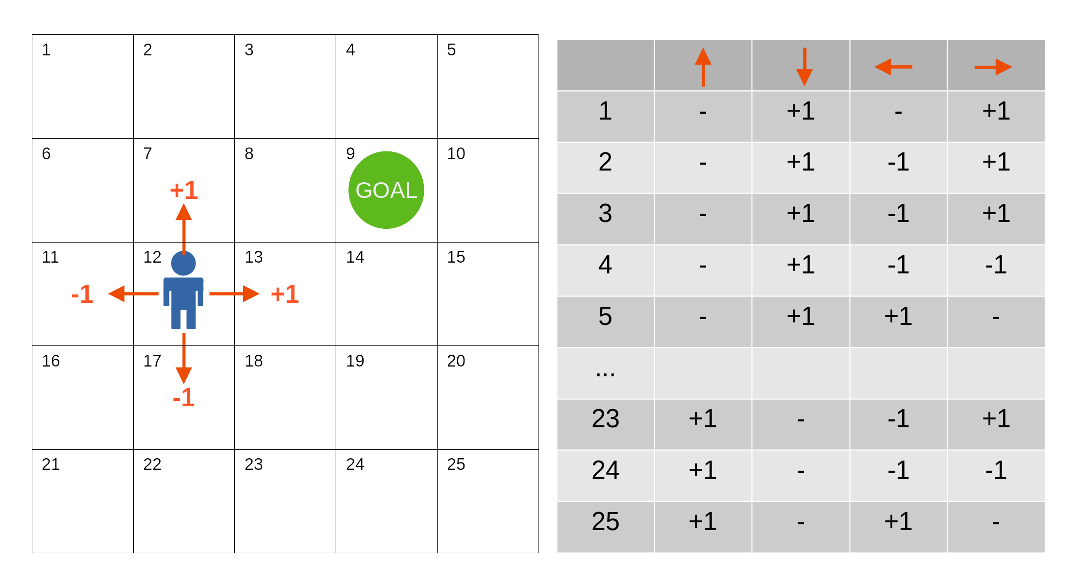
Q-Learning Approach
How the Reward Function and Q-Table Work Together:
The Q-Table stores the agent’s knowledge about which action is best in each possible situation. It acts as a memory, mapping state–action pairs to numerical values (Q-values) that represent the expected future reward for taking that action in that state.
The Reward Function provides immediate feedback after the agent takes an action. A positive reward encourages repeating similar actions in the future, while a negative reward discourages them.
Process:
The agent takes an action in the current state.
The environment returns a reward based on the reward function.
The agent updates the corresponding Q-value in the Q-Table using this reward.
Over time, as this process repeats, the Q-Table is refined to guide the agent toward the most rewarding actions.
In essence, the reward function acts as the teacher giving feedback, while the Q-Table is the notebook where the agent records and improves its strategy.

Slide 9
Expected Outcomes
Reduced Average Waiting Time: Demonstrable decrease in vehicle waiting times at intersections under adaptive control compared to fixed-time signals.
Adaptive Signal Control: Successful implementation of a traffic control system that dynamically responds to real-time traffic flow, optimizing green light allocation.
Reinforcement Learning Demonstration: A practical and effective application of reinforcement learning principles in a complex, real-world engineering problem (traffic management).
Comprehensive Performance Data: Quantitative results showcasing the efficiency improvements achieved by both the Q-learning and heuristic models.

Slide 10
THANK YOU

